Slide 1

UKRAINE
ORT ODESSA #94

Slide 2
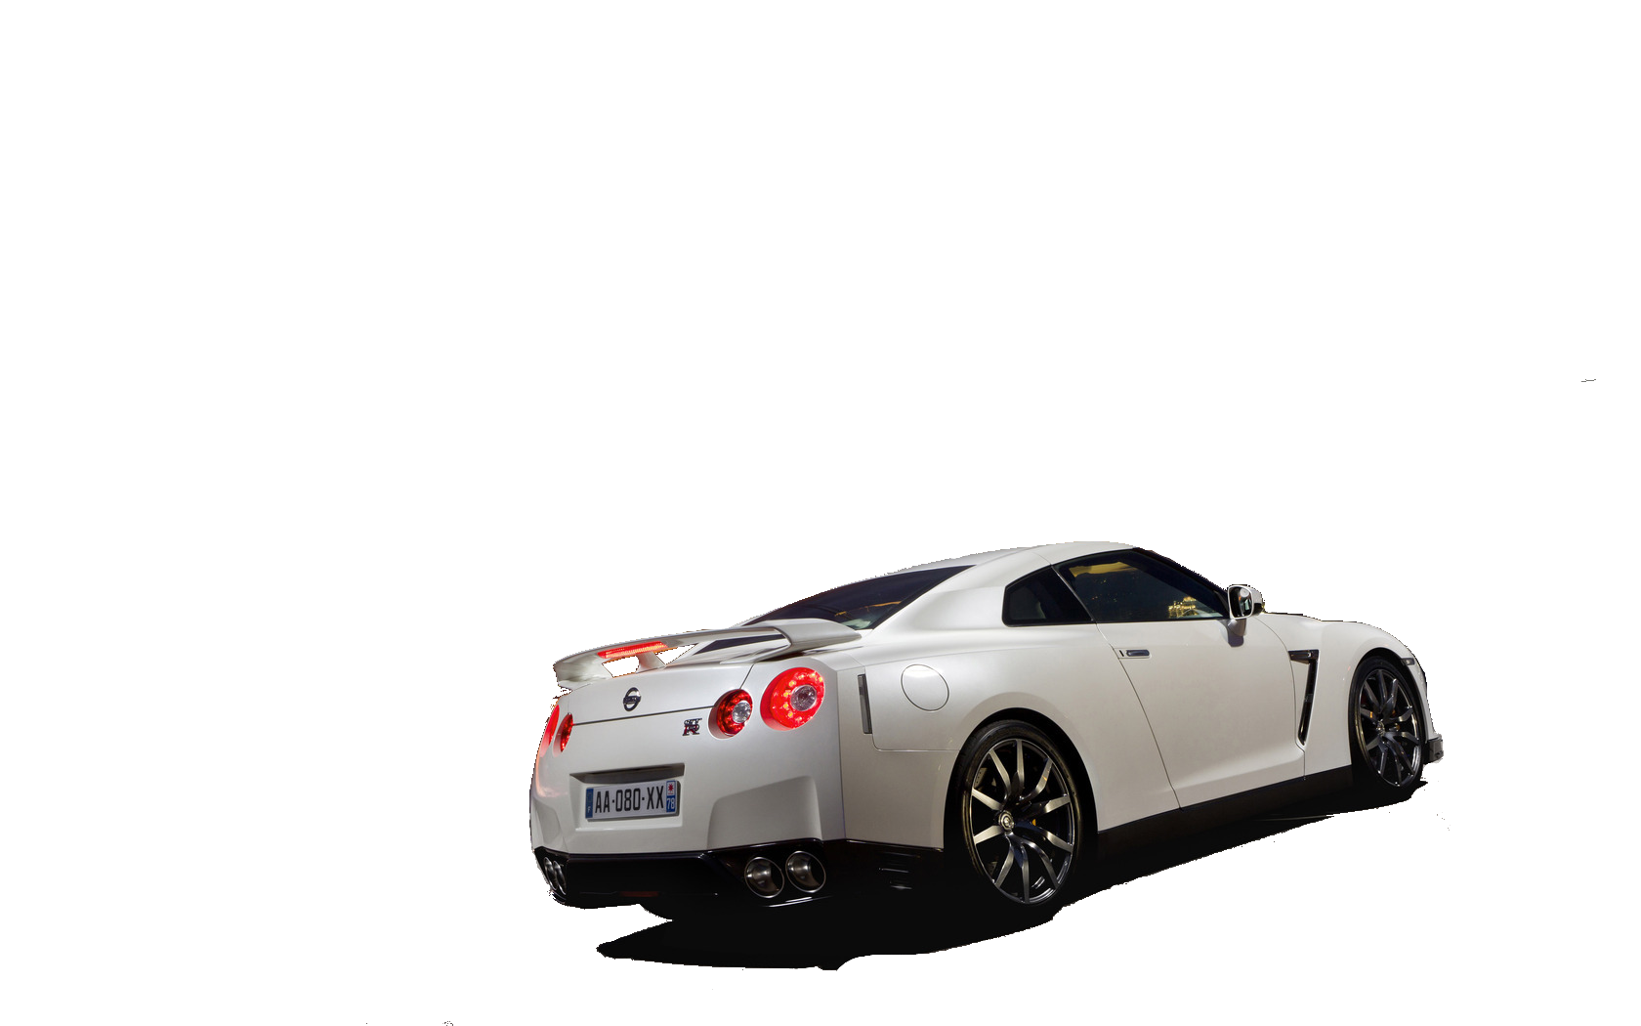
USING OF ARTIFICIAL INTELLIGENCE FOR THE ROAD SAFETY
Authors:
ORT ODESSA 94
TEAM
Supervisors:
Kit I.V., Kit O.G.
GO-BY Pro
Odessa – 2015

Slide 3
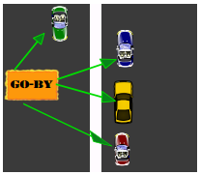
The GO-BY PRO system
GO-BY – is a system that is used to identify vehicles, their size, and other data through the communication channel.

Slide 4

Purpose
Scrutiny of the features applications of robotic systems for safety on the road as one of the areas of artificial intelligence and develop a system to detect and prevent traffic hazard

Slide 5

Our AIM
Our main goal - the creation of a prototype
on-board robotics system
for the vehicle.

Slide 6
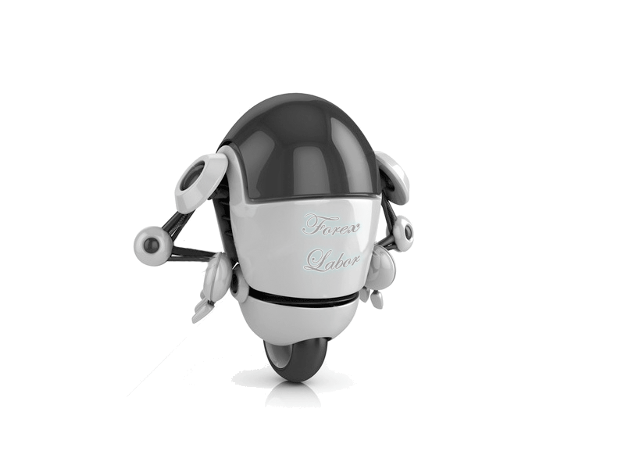
Analysis of the types of accidents on the roads;
Study of methods for the detection and prevention of accidents;
An automated system to detect and prevent traffic hazard.
Tasks

Slide 7
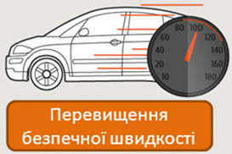
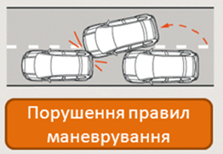
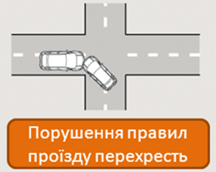
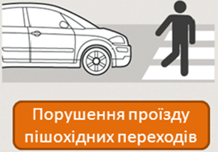
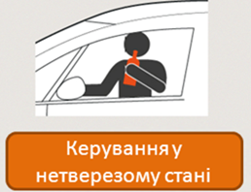
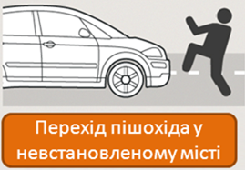
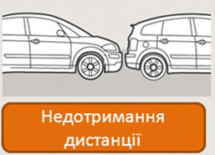
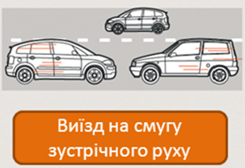
The causes of accidents
Exceeding the safe speed
Faulty maneuvering
Faulty intersections map
Violation of pedestrian travel
Driving drunk
Go prohibited pedestrians in city
Failure distance
Check into oncoming traffic

Slide 8

Solutions:
Instruction
of the
drivers
and
pedestrians
Improvement
of roads
and vehicle
Scientific
progress
usage

Slide 9
The GO-BY PRO system
Purpose:
Improving the safety of vehicles through the following functions:
control safe distance and speed;
control safe the later distance
prevention of collisions when overtaking vehicles;
obtain information about road users

Slide 10
Components of the “GO-BY PRO”
Distance sensors
The modulator
/ demodulator
FM-transmitter
FM-receiver
The GPS receiver
The electronic control unit
Devices maintenance information
Output devices information

Slide 11
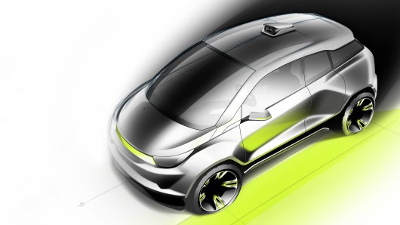
Our system can work in two modes:
A simplified
The Full
With simple mode the system will work without a GPS sensor, thus disconnecting function overtaking. But it will be much cheaper. In full mode, the system will perform all the original features and GPS sensor will have an extra 1-3 check functions.

Slide 12
The principle of operation
Message GO-BY PRO contain:
identifying information about the car (ID of the vehicle);
the geographic coordinates that GO-BY receives satellite navigation system GPS;
information about vehicle speed
information is entered manually owner of the dimensions of the car.

Slide 13
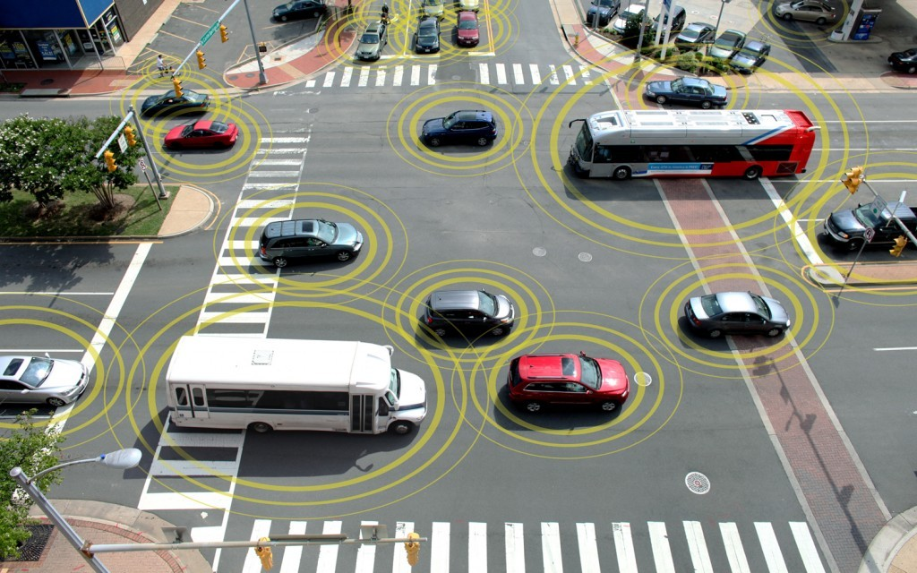
Functions
Monitoring compliance with safe distance
Monitoring compliance with the safe side of the interval
Speed control
Overtaking control

Slide 14

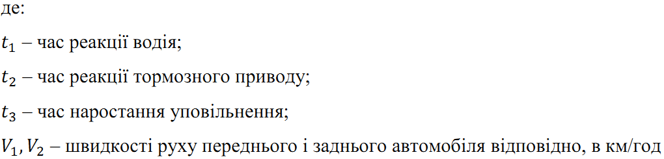
Monitoring compliance
with safe distance
- Calculation of the safe distance
s
Where:
driver's reaction time
reaction time stopping distance
rise time delay
the speed of the front car and of the rear car, km/h

Slide 15

Control of the observance of a safe distance
$S_{г}=\frac{V^{2}}{26{∙I}_{г}}$ - calculation of braking
where:
$I_{г}=\frac{g∙φ}{K_{е}}$ - settlement values
deceleration when braking;
$g=9.81 м/{с^{2}}$ – acceleration of free fall;
$φ$ – coefficient of traction tire with the surface (see table 1);
$K_{е}$ – the possible reduction in the efficiency of braking
$K_{е}∈(1.1;1.6)$.

Slide 16
Control of the observance of a safe distance
Surface | The Coefficient
Dry asphalt | 0,9
Wet asphalt | 0,7
Gravel | 0,4
Snow | 0,2
Ice | 0,1

Slide 17
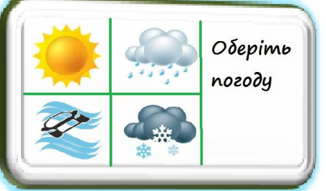
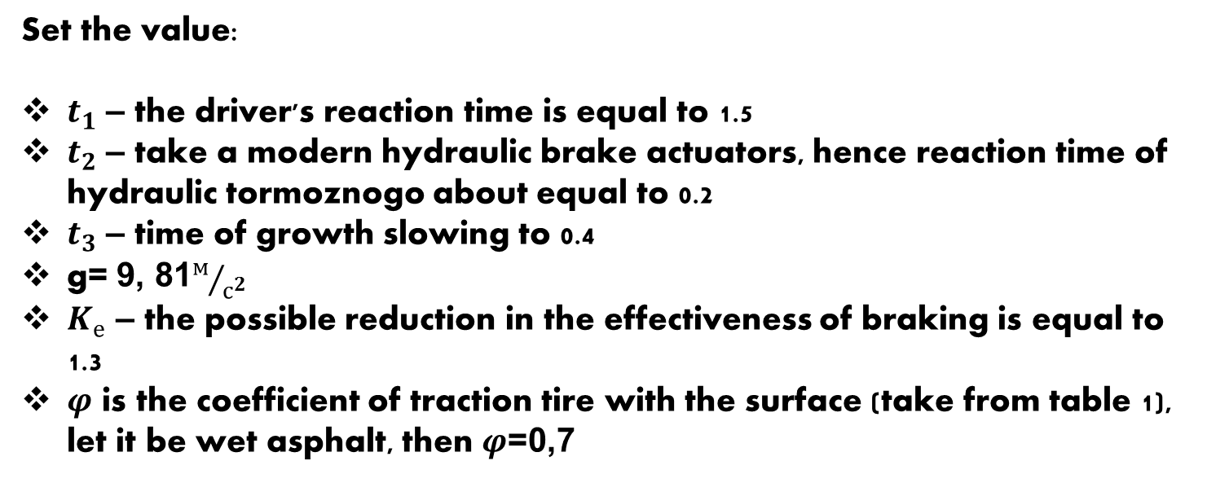
Control of the observance of a safe distance
Set the value:
$t_{1}$ – the driver's reaction time is equal to 1.5
$t_{2}$ – take a modern hydraulic brake actuators, hence reaction time of hydraulic tormoznogo about equal to 0.2
$t_{3}$ – time of growth slowing to 0.4
g= 9, 81$м/{с^{2}}$
$K_{е}$ – the possible reduction in the effectiveness of braking is equal to 1.3
$φ$ is the coefficient of traction tire with the surface (take from table 1), let it be wet asphalt, then $φ$=0,7

Slide 18
Control of the observance of a safe distance
Setting the parameter φ
Getting the distance d to the car ahead and its velocity V1
2
Calculation of safe distance Db to the car ahead
YES
D_{б}>d
NO
Move to the previous speed V2
decrease speed V2
2. a warning to the driver
1
1
Implementation of GO-BY system functions

Slide 19



Control of adherence to safe lateral spacing
Even in the 20th century, Professor m.s.
Zamahaêv brought out the formula to calculate
safe lateral spacing in meters:
where:
-lateral spacing in the opposite movement of the vehicle.
-side spacing when passing motion of vehicle.

Slide 20
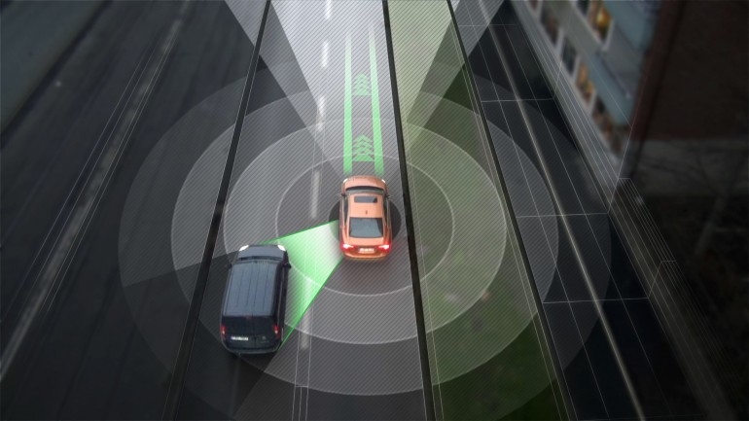
Control of adherence to safe lateral spacing

Slide 21
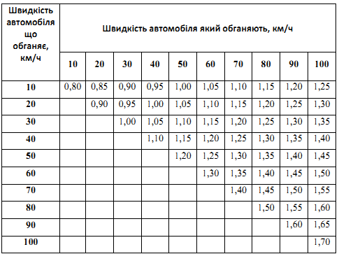
Control of adherence to safe lateral spacing
Car speed which overtakes km/h
The speed of the car which are overtaking, km/h
Dependence of lateral spacing speed

Slide 22
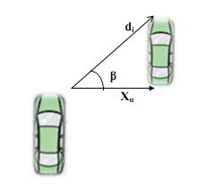
Control of adherence to safe lateral spacing
Using the formula, you can automate the process of calculating safe lateral spacing . The system uses two sensor distance, but are under some angle β to the longitudinal axis of the vehicle, which will determine a safe interval to " foresight "

Slide 23
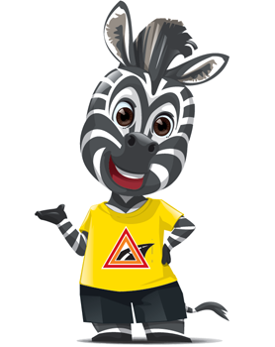
Control of adherence to safe lateral spacing
Get the value of a dì vehicle side and its velocity V2
Calculation of safe distance Cps to the car ahead
Х_{п}>d_{і}×sinβ or
Х_{п}<d_{і}×sinβ
YES
NO
A warning to the driver
Implementation of system functions GO-BY

Slide 24
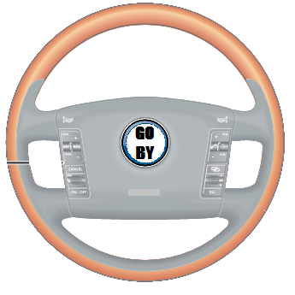
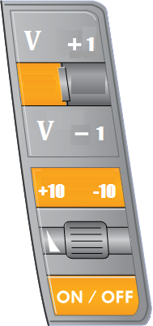
Speed control
GO-BY Pro system providing well control the speed of the car, working in three modes: acceleration, deceleration, constant speed.
Selecting the speed by using the multifunction steering wheel.

Slide 25
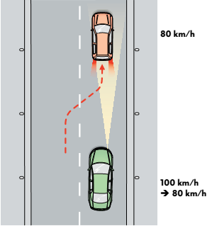
Speed control
Motion with
constant speed
If in the zone of coverage of the sensor GO-BY Pro vehicles there, then supported, given the speed of the car.
Fig. 11. mode "Constant speed"

Slide 26
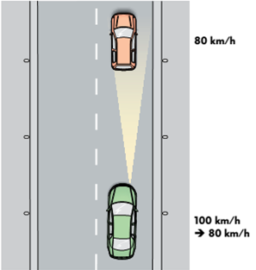
Speed control
2. slow down
If a car (green) equipped with GO-BY Pro System while moving on its line takes over vehicle ahead (red), that moves slowly, then GO-BY Pro decreases speed of a car.
Fig. 11. mode "slowing down"

Slide 27
Speed control
3. Acceleration
If moving ahead of vehicle increases its speed or changing Lane, a car "with" again accelerated to the set first, speed.
Fig. 11. the regime of the "speed"

Slide 28
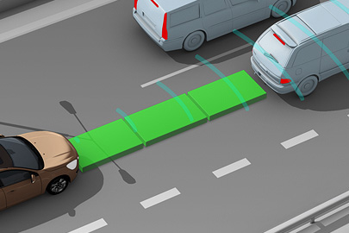
GO-BY PRO System
When activating the function "speed control" system GO-BY is also monitoring the safe distance.

Slide 29
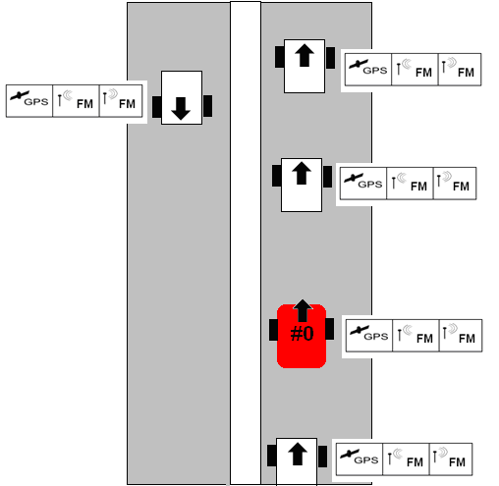
The System Overtaking
Step 1.
Getting coordinates from the GPS
Step 2. Determination of movement
Step 3.
Build your own coordinate system
Step 4.
Checking the possibilities of overtaking

Slide 30
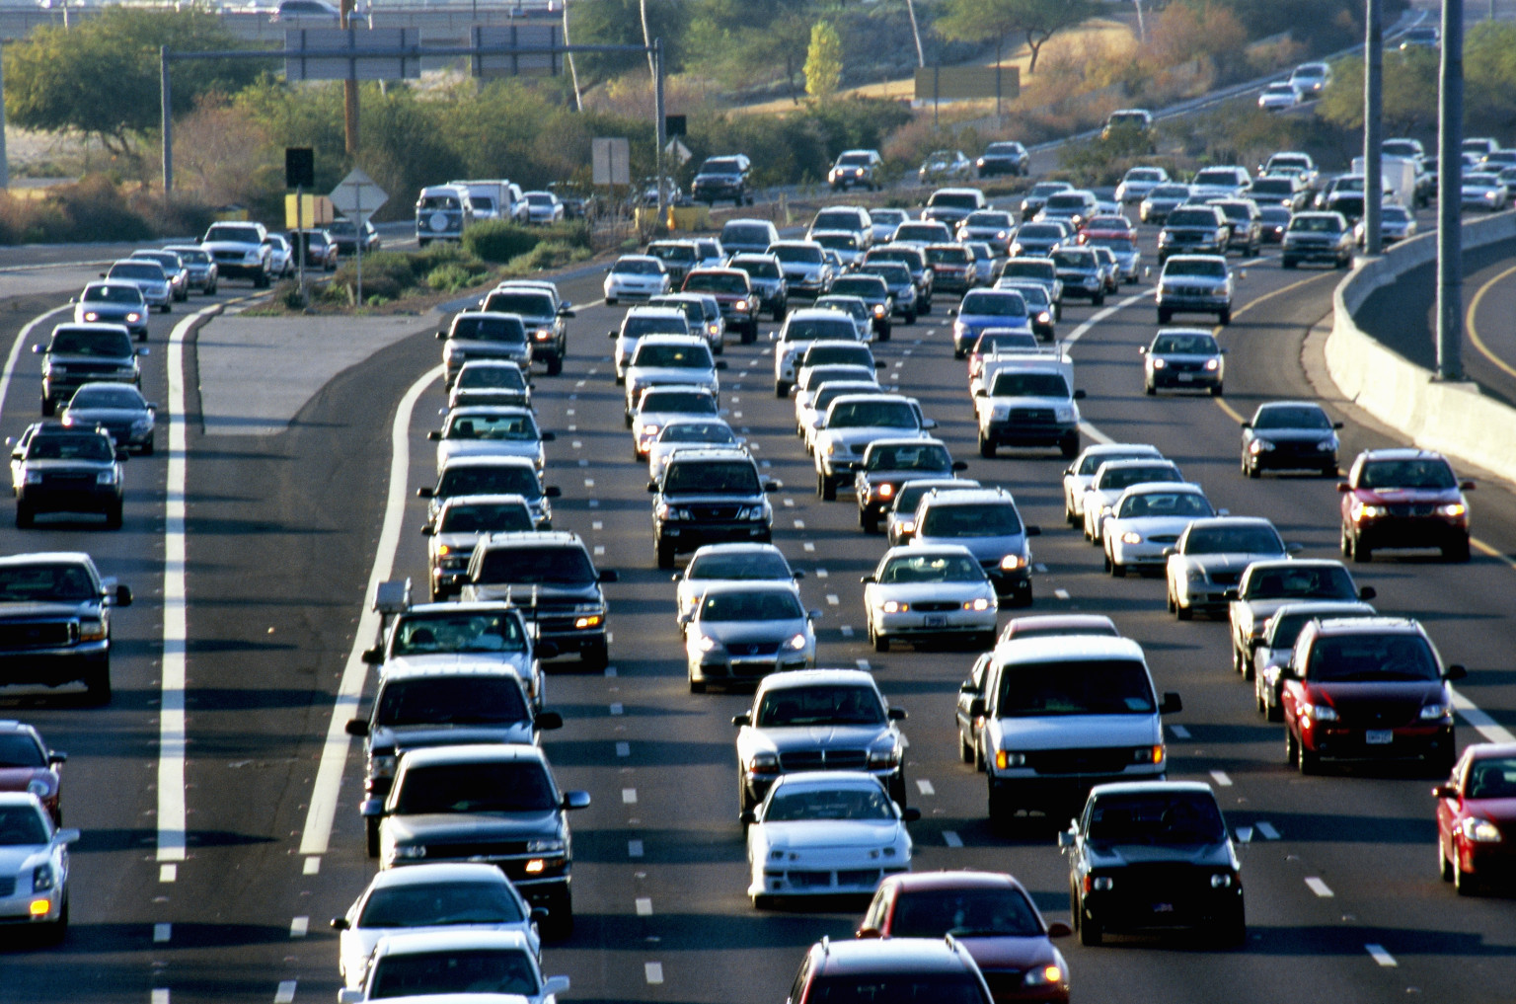
If you want to feel confident on the road Choose system Go-by Pro

Slide 31

